Slide 1

SUPER MARKET BILLING SYSTEM
19K-1361 SHEIKH ABDUL BASIT
19K-0154 HAMZA SIDDIQUI
19K-0151 SALMAN ALI
OOP SECTION C

Slide 2
About:
This supermarket billing system is a simple console application built in C++without the use of graphics. This project will help you understand basically two things
use of stream class and file handling in c++ programming language. There are several classes, class billing, class Inventory, class Accountant, class employee and its derived classes Dept manager and Sales person which can be found in this project. The project is simple to understand, and the source code has been presented in an understandable manner
Understanding the source code will give you the idea regarding file handling, how to add, remove, edit, and search data or info to/from file.

Slide 3
Problem faced
Syntax errors .
Logical errors.
Leakage in filing.
Uses of header files.
Buffers were not cleared.

Slide 4
PURPOSE:
The purpose of this program is to build it in a way to reduce the manual work for supermarkets for billing. It provides searching facilities to admin to search for the inventory and to check weather the items quantity are stable or not. Admin can check the details of its employee sales and also manage it easily.

Slide 5
FEATURES:
Listed below are the key features of this project:
BILLING: It generates the bill of items and it also shows the bill report of all the items added in supermarket billing system.
INVENTORY: it enables admin to add the inventory of items in store or to check the quantity of items you have in your inventory
ADMINISTRATION: it enables the admin to create new account of employee and also you can check the sales report of that employee.

Slide 6
PAC CHART
INPUT | PROCESSSNG | OUTPUT
Select user type | Enter choice for billing | Display billing details
Enter isbn number | inventory | Display inventory details.
Enter employee name | Administration | Display Administration portal and sales reports.

Slide 7
HIPO CHART
SUPERMARKET BILLING SYSTEM
0000
Input
1000
Processing
2000
Output
3000
User Type
1100
BILLING
2100
Employee
2300
Print Desired Option
3100
INVENTORY
2200
ISBN NUMBER
For billing
1110
ISBN NUMBER to check inventory
1120
Employee name
1130
Details
Report
Update
2300

Slide 8
LIBRARIES USED:
#include<iostream>
#include<ctime>
#include<fstream>
#include<stdio.h>
#include<string.h>
#include<conio.h>

Slide 9
HOW DOES YOUR SOLUTION FIT THE PROBLEM?
This Supermarket billing system is capable of storing inventory data and also you can update your inventory data.
This system is capable of adding and deleting inventory items.
The system is capable of storing the whole employee record from his personal details to his sales details without any ambiguity in records.
This system is capable of generating bills for customers with ease without any hassle of maintaining records in hardcopy.
Admin has the facility to update any record of inventory and employee without mismanagement.

Slide 10
Work Management/CONTRIBUTION
Program Modules | Sheikh Abdul Basit | Salman Ali | Hamza Siddiqui
Time given | 2hrs/week | 2hrs/week | 2hrs/week
Work Allotted | MAIN LAYOUT portal,SALES PERSON ,DEPT MANAGER and header files | Administration portal AND EMPLOYEE portal and functions related to it | Inventory portal and Billing portal and functions related to it

Slide 11
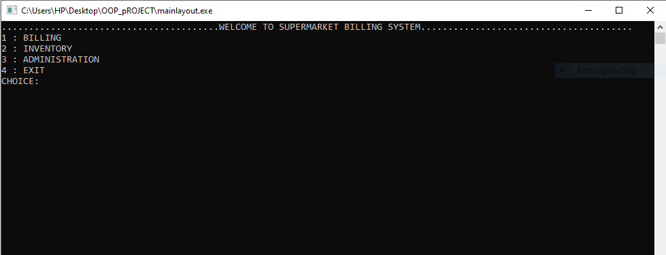
MAIN LAYOUT

Slide 12
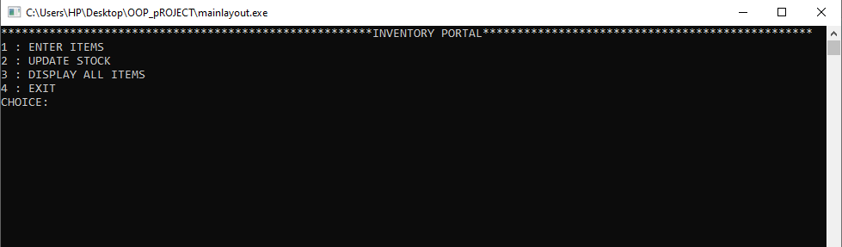
INVENTORY PORTAL:

Slide 13
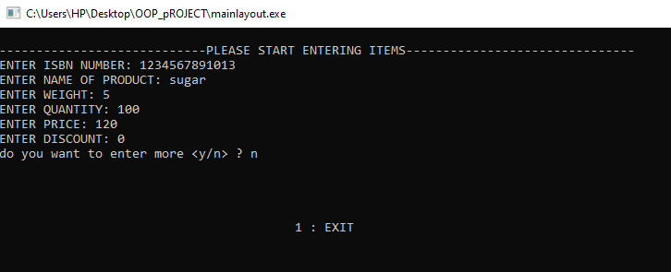
INVENTORY ENTRY

Slide 14
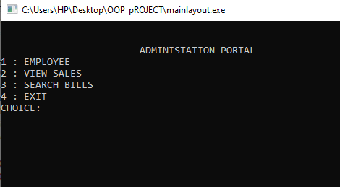
ADMINISTRATION PORTAL

Slide 15
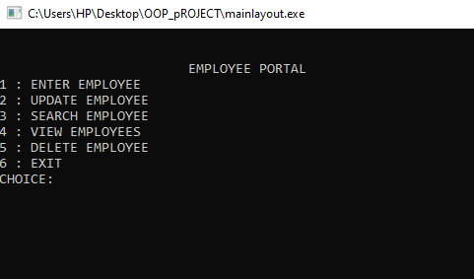
EMPLOYEE PORTAL

Slide 16
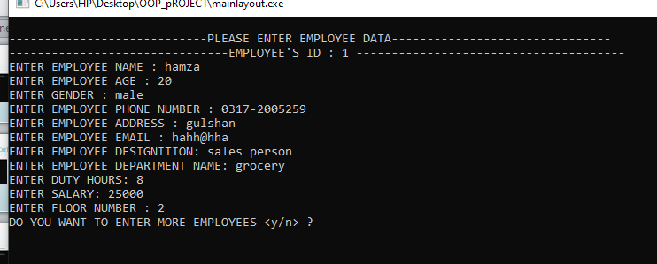
Employee entry:

Slide 17
Concepts used:
Inheritance.
Filing.
Friend Function.
Friend Class
Abstraction
Encapsulation.
Header Files.
Operator Overloading

Slide 18
THANKS

